Slide 1


Betty Schrampfer Azar
Stacy A. Hagen
Teacher Resource Disc
Slide shows for use with
PowerPoint presentation software
Laurette Poulos Simmons
Copyright © 2007 by Pearson Education, Inc.
All rights reserved.

Slide 2

CONTENTS
7-1 Nouns: count and noncount
7-2 Using an vs. a
7-3 Using a/an vs. some
7-4 Measurements with noncount nouns
7-5 Using many, much, a few, a little
7-6 Using the
7-7 Using ø (no article) to make generalizations
7-8 Using some and any

Slide 3
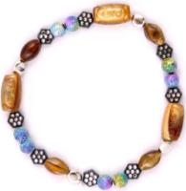
7-1 NOUNS: COUNT AND NONCOUNT
one bracelet
three bracelets
two bracelets

Slide 4
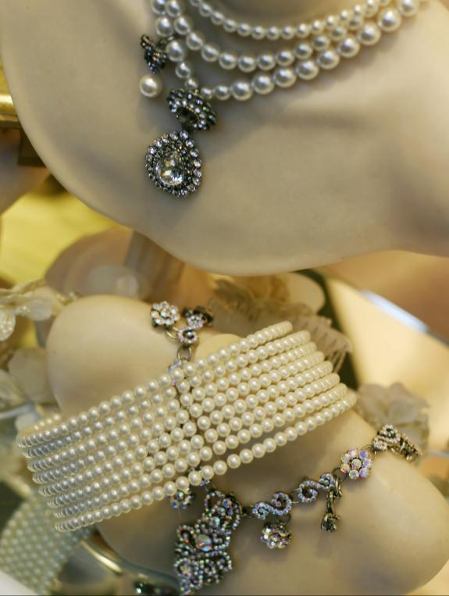
7-1 NOUNS: COUNT AND NONCOUNT
one bracelet
two bracelets
some jewelry
three bracelets

Slide 5
7-1 NOUNS: COUNT AND NONCOUNT
SINGULAR
PLURAL
COUNT
NOUN
a pen
pens
one pen
three pens
some pens
a lot of pens
A COUNT NOUN
PLURAL:
noun + -s
SINGULAR:
a + noun
one + noun

Slide 6
7-1 NOUNS: COUNT AND NONCOUNT
SINGULAR
PLURAL
NONCOUNT
NOUN
jewelry
(no plural form)
some jewelry
a lot of jewelry
A NONCOUNT NOUN
SINGULAR:
No - a
No - one
PLURAL:
No plural
form.

Slide 7
7-1 Let’s Practice
NOUN
?
We love to read books.
?
count
noncount

Slide 8
7-1 Let’s Practice
NOUN
?
I am studying grammar.
?
count
noncount

Slide 9
7-1 Let’s Practice
NOUN
?
Please pass the salt.
?
count
noncount

Slide 10
7-1 Let’s Practice
NOUN
?
We need some chairs.
?
count
noncount

Slide 11
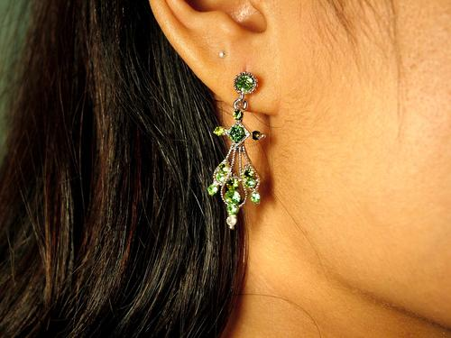

7-2 USING AN vs. A
a bracelet
an earring

Slide 12
7-2 USING AN vs. A
(a) A cow is an animal.
A
an
singular count nouns

Slide 13
7-2 USING AN vs. A
(b) I have an idea.
(c) My friend has an old horse.
words that begin
with vowels
an

Slide 14
7-2 USING AN vs. A
(d) I have an ugly dog.
(e) I have a useful idea.
/uh/ vowel sound
/yu/ sound

Slide 15
7-2 USING AN vs. A
(f) Give me an honest answer.
(g) Today is a hot day.
silent /h/, vowel sound
/h/ sound

Slide 16
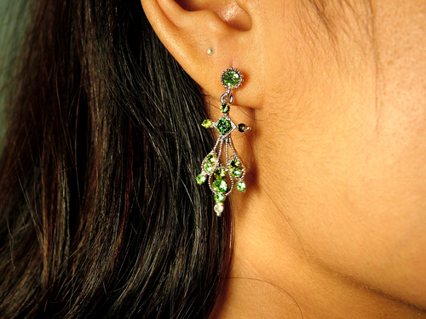
7-2 Let’s Practice
a an
I lost ___earring.
an

Slide 17
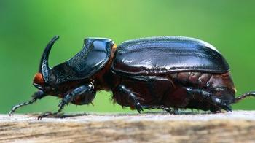
7-2 Let’s Practice
a an
That is ___ ugly bug.
an

Slide 18
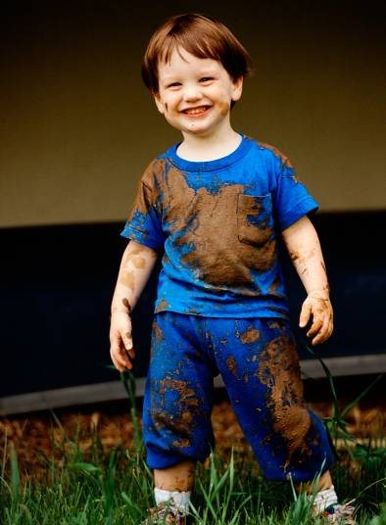
7-2 Let’s Practice
a an
He is __ happy child.
a

Slide 19
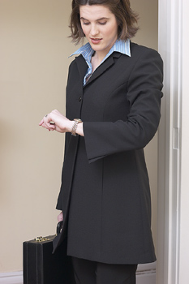
7-2 Let’s Practice
a an
Let’s go in __ hour.
an

Slide 20
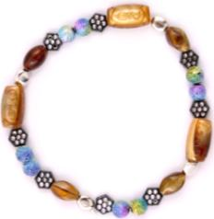
7-3 USING A/AN vs. SOME
some bracelets
a bracelet

Slide 21
7-3 USING A/AN vs. SOME
(a) I have a book.
She has an umbrella.
(b) We have some apples.
You have some soccer balls.
(c) I got some mail.
He has some information.
singular count nouns
plural count nouns
noncount nouns

Slide 22
7-3 Let’s Practice
a an some
a
She has _____ hat on her head.
singular count noun

Slide 23
7-3 Let’s Practice
a an some
She has _____ nice hats.
some
plural count noun

Slide 24
7-3 Let’s Practice
a an some
I need _____ water to wash my hands.
some
noncount noun

Slide 25
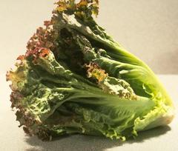
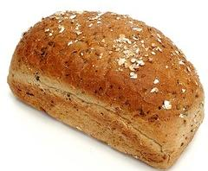
7-4 MEASUREMENT WITH NONCOUNT NOUNS
a head of lettuce
a loaf of bread

Slide 26
7-4 MEASUREMENTS WITH NONCOUNT NOUNS
(a) I’d like some juice.
(b) I’d like a glass of juice.
(c) I’d like a cup of tea.
(d) I’d like a piece of fruit.
an unspecified quantity
a specified quantity

Slide 27
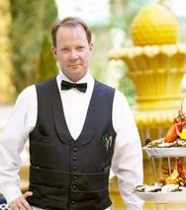
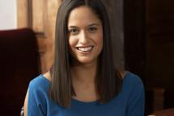
7-4 MEASUREMENTS WITH NONCOUNT NOUNS
What would you like to drink?
I’d like some water, please.

Slide 28
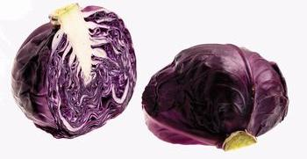
7-4 Let’s Practice
cabbage
We need to buy a head of _______.
beans
cabbage
bread
cereal

Slide 29
7-4 Let’s Practice
Please hand me a loaf of _______.
bread
beans
cabbage
bread
cereal

Slide 30
7-4 Let’s Practice
I need to find a can of ______ for dinner.
beans
beans
cabbage
bread
cereal

Slide 31
7-4 Let’s Practice
Do you have a box of ______?
cereal
beans
cabbage
bread
cereal

Slide 32
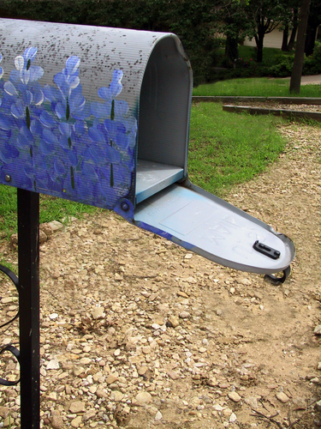
7-5 USING MANY, MUCH, A FEW, A LITTLE
I don’t get many letters.

Slide 33
7-5 USING MANY, MUCH, A FEW, A LITTLE
(a) I don’t have many bracelets.
(b) I’d don’t have much jewelry.
(c) Gina has a few earrings.
(d) I’d like a little fruit.
PLURAL COUNT noun
NONCOUNT noun
PLURAL COUNT noun
NONCOUNT noun

Slide 34
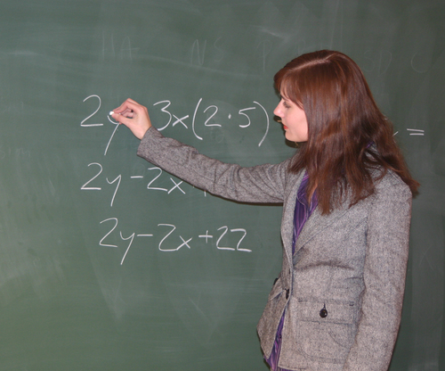
7-5 Let’s Practice
She gives us some homework everyday.
She gives us a little homework everyday.
A few or a little
?

Slide 35
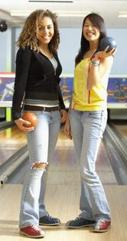
7-5 Let’s Practice
Katie has some friends.
Katie has a few friends.
a few or a little
?

Slide 36
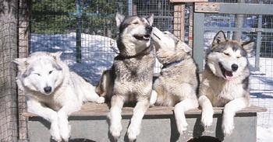
7-5 Let’s Practice
We have many dogs.
We have a lot of dogs.
many or much
?

Slide 37
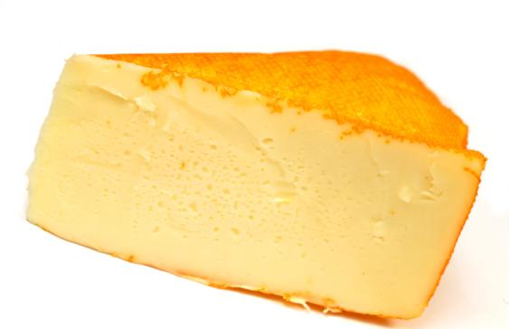
7-5 Let’s Practice
I don’t eat a lot of cheese.
I don’t eat much cheese.
many or much
?

Slide 38
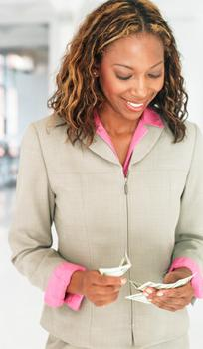
7-8 USING SOME AND ANY
Alice has some money.

Slide 39
7-8 USING SOME AND ANY
STATEMENT
(a) Alice has some money.
(b) Alice doesn’t have any money.
(c) Does Alice have any money?
(d) Does Alice have some money?
some in affirmative statements
NEGATIVE
any in negative statements
QUESTION
either some or any in questions

Slide 40
7-8 USING SOME AND ANY
(e) Graham doesn’t have any money.
(f) Graham doesn’t have any coins.
noncount noun
plural count noun
any + noncount nouns
any + plural count nouns

Slide 41
7-8 Let’s Practice
some any
some
I need _____ time to study.

Slide 42
7-8 Let’s Practice
some any
We don’t have _____ cheese.
any

Slide 43
7-8 Let’s Practice
some any
some
All children should have _____ books.

Slide 44
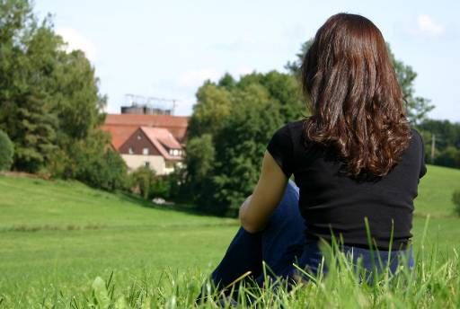
7-8 Let’s Practice
some any
There aren’t _____ horses in the field.
any

